Slide 1
ProStructures CONNECT Edition
Advancing Your Projects by Connecting Your World
© 2016 Bentley Systems, Incorporated
Notes:
The presentation provides a sneak preview of a few of the new features in the upcoming Bentley Substation CONNECT Edition Release.

Slide 2
ProStructures CONNECT Edition Highlights
Functional Components
Component Center
Documentation Center
Tables and Reports
Annotation

Slide 3
Advancing Infrastructure
Connected Performance Environment
Comprehensive Modeling Environment
The CONNECT Edition
Connected Data Environment
Notes:
At last year’s Year In Infrastructure event we introduced “The CONNECT Edition” with MicroStation and ProjectWise and the ideas behind the CONNECT Edition that are made up having CONNECTED Performance Environment for improved collaboration and visibility, a Comprehensive Modeling Environment for modeling and design of all infrastructure types and a Connected Data Environment that enables these modeling and design application to interoperate with one another.

Slide 4
Benefits of AECOsim Building Designer CONNECT Edition
Cloud Services
Web Portals
CONNECT Edition
Azure
ProjectWise
CONNECT Edition
CONNECTION
Client
Office
Field
Notes:
The CONNECT Edition is a web and cloud service platform which is provisioned using the Microsoft Azure Cloud that enables desktop, server and field applications to better collaborate and provide users a better connected experience.

Slide 5
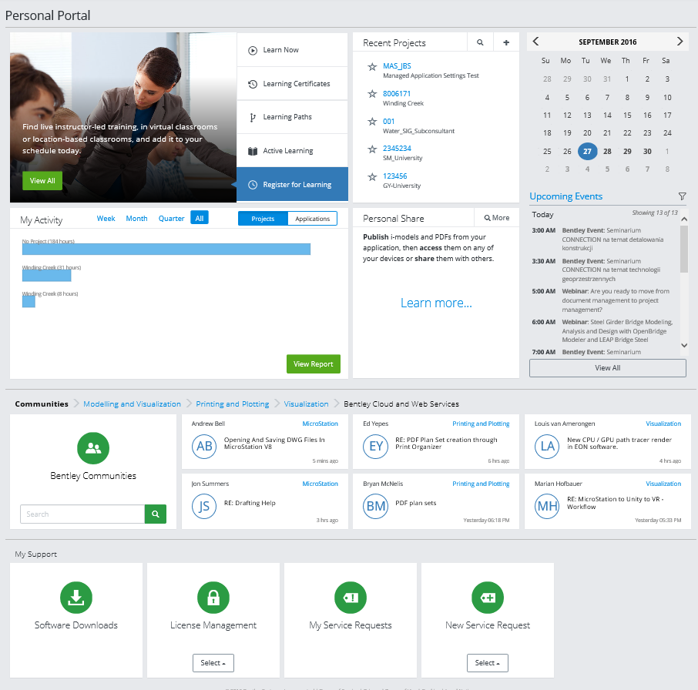
1. Improve Business Outcomes
AECOsim Building Designer CONNECT Edition provides:
A CONNECTED Performance Environment for improved collaboration and visibility
A Comprehensive Modeling Environment for modeling and design of all infrastructure types
A Connected Data Environment that enables modeling and design applications to work with one another.

Slide 6
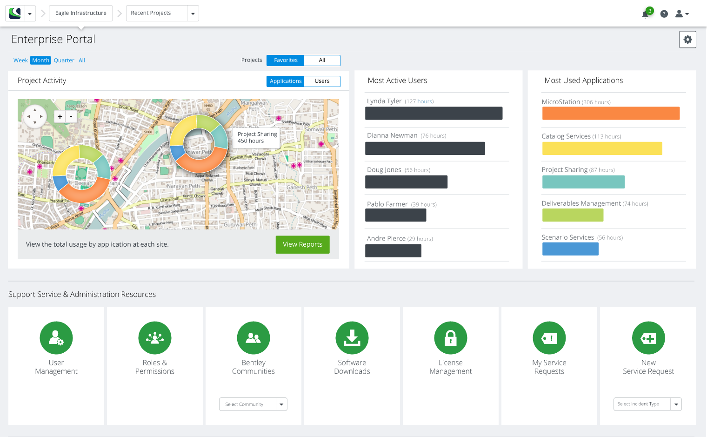
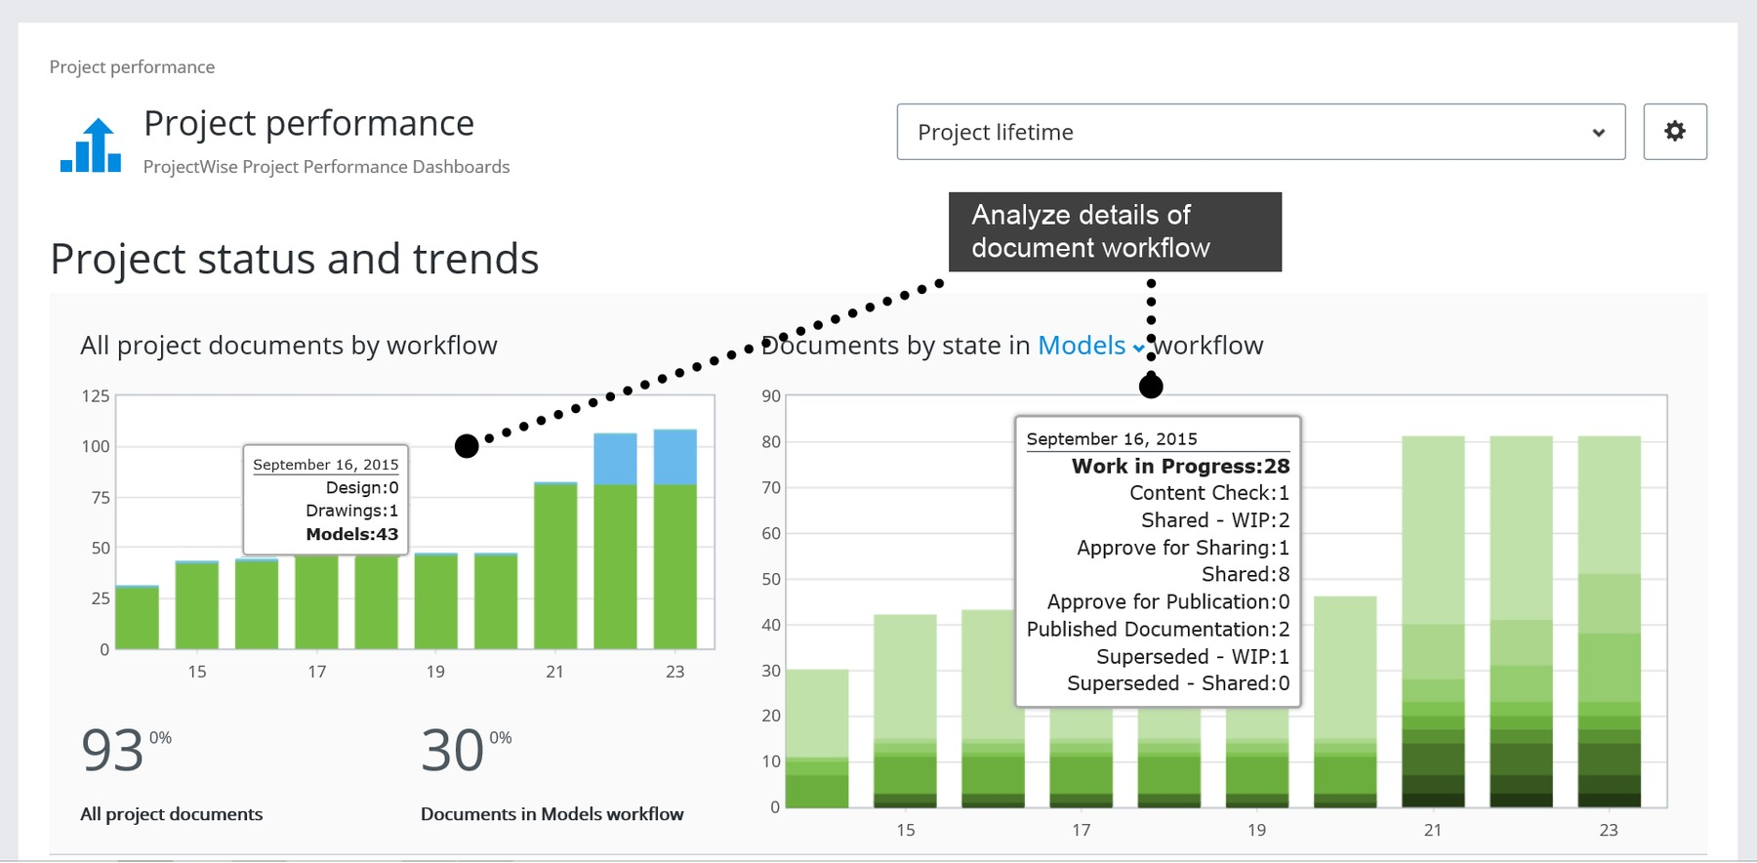
2. Do What You Do Better
Publish i-model and PDFs from your CONNECT Edition applications to your devices to share with others.
Gain a better understanding about projects you are participating directly within each product.
Access capabilities and relevant LEARN content via your portal.
Notes:
Connected users have a one stop hub to gain instant access to capabilities, content and relevant learning content with a cloud-based personalized experience.
Access Bentley Communities and Support, publish i-model and PDFs from your CONNECT Edition applications and then publish to your devices to share with others.
Gain a better understanding about projects you are participating directly within each product.
Quickly access to LEARN content, product videos, and more to increase your skills and productivity.

Slide 7
3. Use a Comprehensive Modeling Environment
Unite design and construction from concept through construction with integrated workflows.
Capture the “as-built” condition of an existing site or asset to quickly produce 3D models from photographs.
Use reality meshes to provide continuous contextual data in project lifecycle.
Take advantage of easy and intuitive modeling workflows that are well integrated, and provide the flexibility needed to capture design intent.
Leverage Component Center to manage and deliver Functional Components, enabling rapid and consistent parametric design across the engineering workgroup.
Notes:
Connected users have a one stop hub to gain instant access to capabilities, content and relevant learning content with a cloud-based personalized experience.
Access Bentley Communities and Support, publish i-model and PDFs from your CONNECT Edition applications and then publish to your devices to share with others.
Gain a better understanding about projects you are participating directly within each product.
Quickly access to LEARN content, product videos, and more to increase your skills and productivity.

Slide 8
4. Automate Drawing Production
Automate production of high-quality drawings using the new Documentation Center.
Access a live view of the project in sheet orientation.
Edit the design and the sheets automatically update.
Notes:
Connected users have a one stop hub to gain instant access to capabilities, content and relevant learning content with a cloud-based personalized experience.
Access Bentley Communities and Support, publish i-model and PDFs from your CONNECT Edition applications and then publish to your devices to share with others.
Gain a better understanding about projects you are participating directly within each product.
Quickly access to LEARN content, product videos, and more to increase your skills and productivity.

Slide 9
5. Take Advantage of Connected Data Environment
Benefit from the exchange of data throughout the project lifecycle.
Share models, drawings, documents and data securely and efficiently.
Provide data access to fit-for-purpose information for each team member.
Ensure the right data is delivered to the right place at the right time.
Connected Performance Environment
Comprehensive Modeling Environment
The CONNECT Edition
Connected Data Environment
Notes:
Connected users have a one stop hub to gain instant access to capabilities, content and relevant learning content with a cloud-based personalized experience.
Access Bentley Communities and Support, publish i-model and PDFs from your CONNECT Edition applications and then publish to your devices to share with others.
Gain a better understanding about projects you are participating directly within each product.
Quickly access to LEARN content, product videos, and more to increase your skills and productivity.

Slide 10
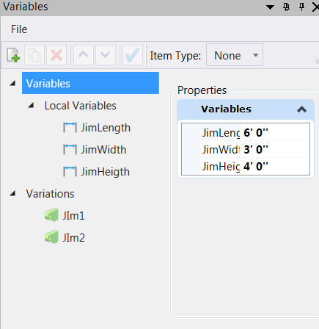
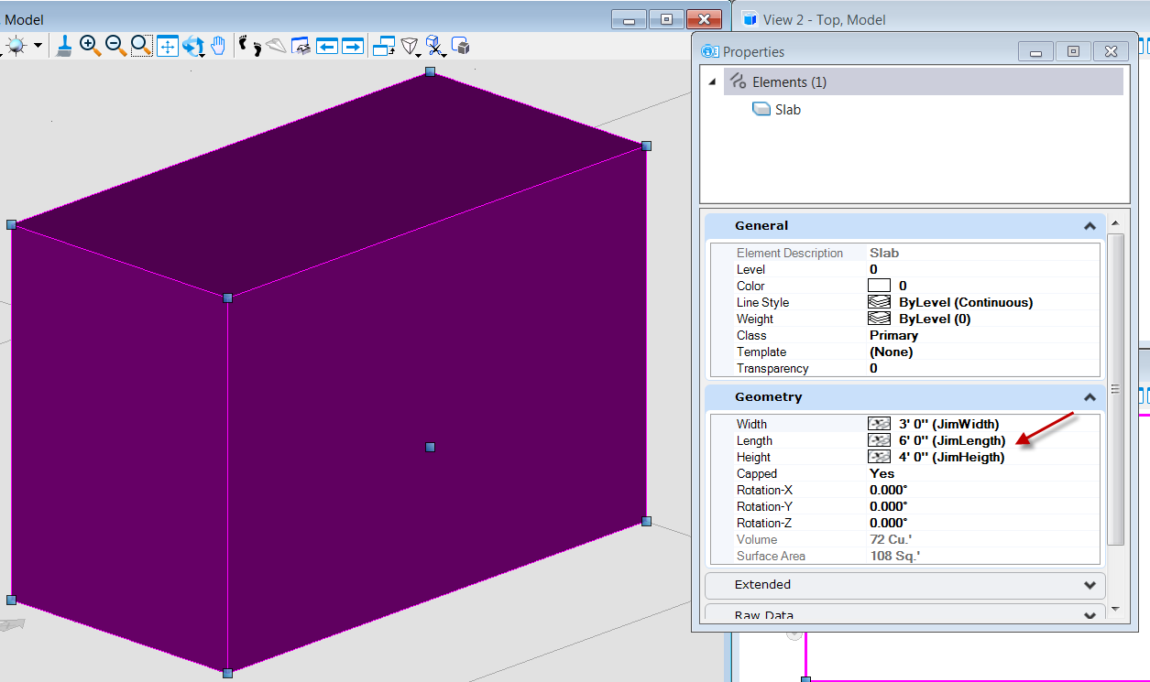
Functional Components
Apply variables and equations to concrete shape dimensions
Increase productivity by eliminating the time and errors of manual data input
Keep drawings up-to-date with integration to in-house engineering calculation spreadsheets
PLEASE NOTE:
*Exact capabilities will be defined when development complete. Workflow and user interface will be defined during development.
Notes:
What’s Different in CONNECT: Apply variables and equations to concrete shape dimensions.
Benefit: Increase productivity by eliminating the time and errors of manual data input. Keep drawings up-to-date with integration to in-house engineering calculation spreadsheets.

Slide 11
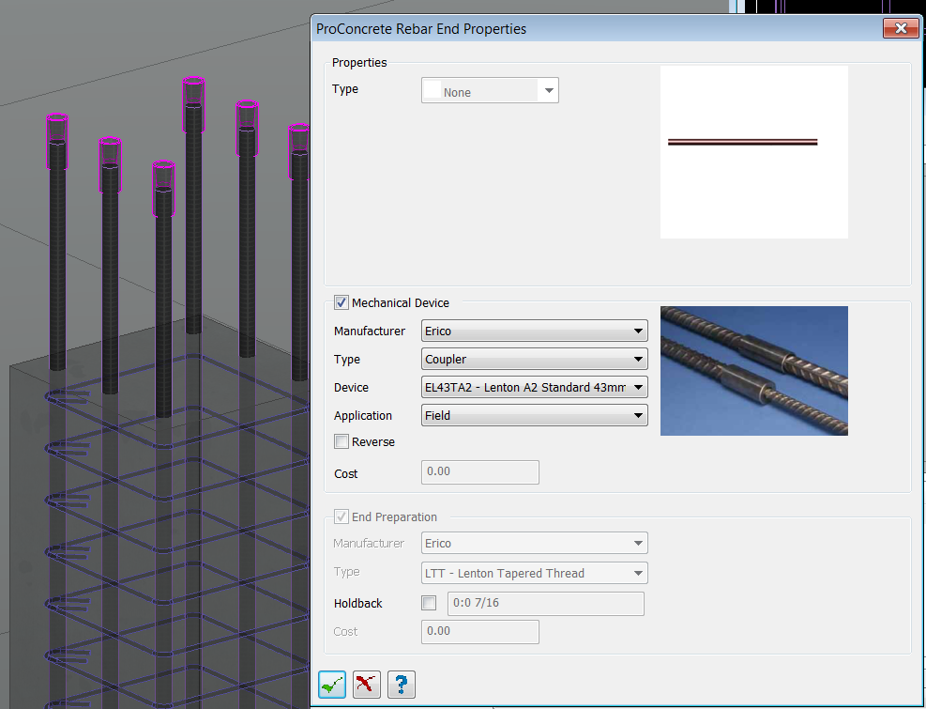
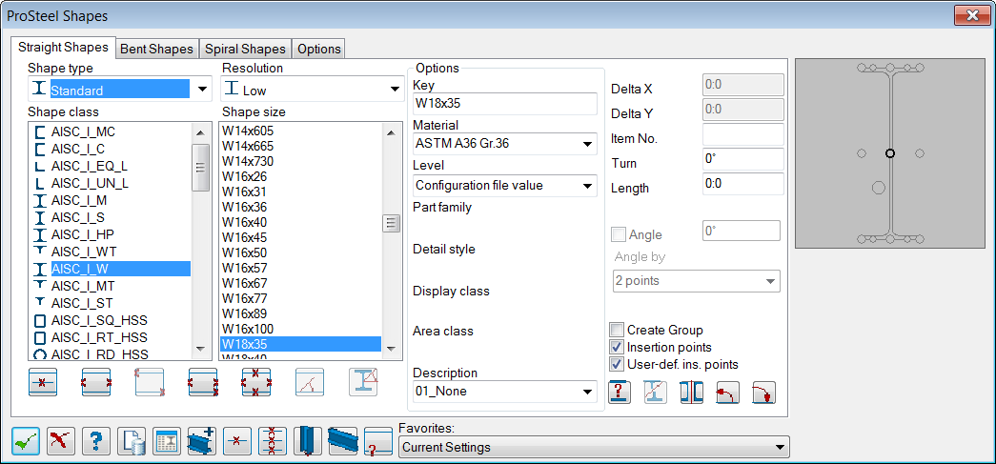
Component Center
Access to the most up-to-date manufacturing content
Browse, select, download, and register design content and store in the cloud
Ensure steel shapes and reinforcing mechanical devices are available for purchase
PLEASE NOTE:
*Exact capabilities will be defined when development complete.
*Workflow and user interface will be defined during development.
Notes:
What’s Different in CONNECT: Access to the most up-to-date manufacturing content for steel shape catalogs and reinforcing mechanical devices. Browse, select, download, and register design content with a project and store in the cloud.
Benefit: Reduce RFIs and other project delays by ensuring steel shapes and reinforcing mechanical devices are available for purchase.

Slide 12
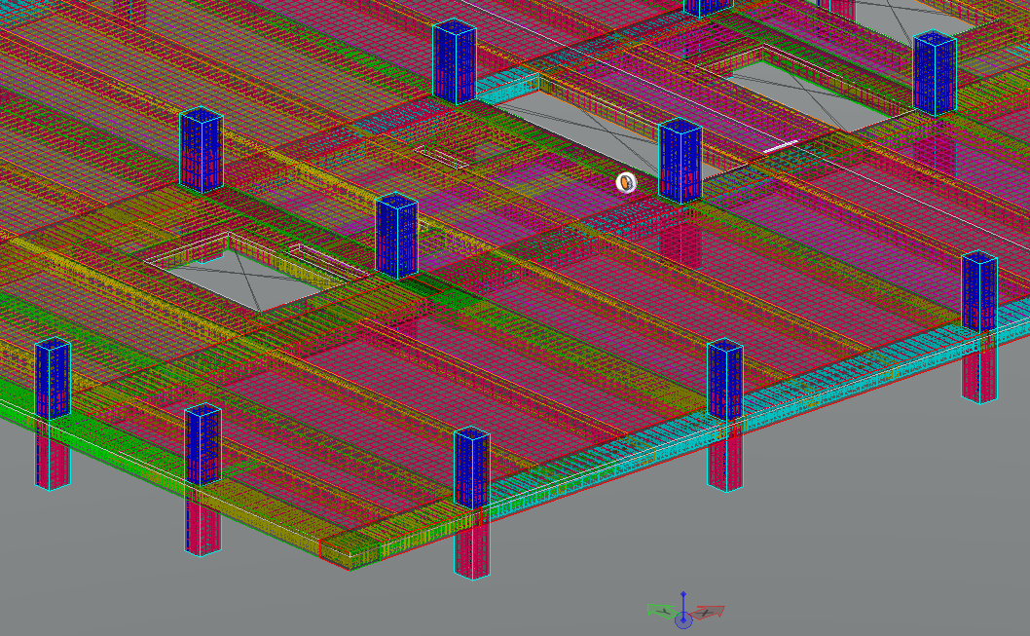
Documentation Center
Aggregate, publish and share, consistent and combined deliverables across disciplines
Avoid design and construction delays by enforcing drafting standards at the attribute level
Reduce errors by using color codes to validate and check models.
PLEASE NOTE:
*Exact capabilities will be defined when development complete.
*Workflow and user interface will be defined during development.
Notes:
What’s Different in CONNECT: Aggregate, publish and share, consistent and combined deliverables across multiple disciplines.
Benefit:
Avoid design and construction delays by enforcing drafting standards at the attribute level (bar sizes, steel shape sizes).
Reduce errors by using color codes to validate and check models.
Documentation Center Example: A user can identify all the bar sizes that are a specific length as blue in the model to visually see if his/her colleague sees the blue in the model, they know that that bar size is that specific length. This works for any attribute that the user thinks is important so they can do a query and see if there are any discrepancies in their model

Slide 13
Tables and Reports
Edit directly in the schedule or in the model to generate two-way in-drawing part list reports and schedules
Save time normally required to quantify, tabulate, and verify reports manually by editing existing data in the schedule.
Schedule updates are automatically reflected in the model and vice versa, reducing the risk that comes with manual entry
PLEASE NOTE:
*Exact capabilities will be defined when development complete.
*Workflow and user interface will be defined during development.
Notes:
Documentation Center Example: A user can identify all the bar sizes that are a specific length as blue in the model to visually see if his/her colleague sees the blue in the model, they know that that bar size is that specific length. This works for any attribute that the user thinks is important so they can do a query and see if there are any discrepancies in their model.
What’s Different in CONNECT: Edit directly in the schedule or in the model to generate two-way in-drawing part list reports and schedules (beam/column schedules, bar bending schedules, footing schedules).
Benefit: Save time normally required to quantify, tabulate, and verify reports manually by editing existing data in the schedule. Schedule updates are automatically reflected in the model and vice versa, reducing the risk that comes with manual entry.
Tables and Reports Example: If a user generates a beam schedule with list of all beams, he/she can edit existing objects’ width, depth, and/or height, he/she directly in the schedule and it will be updated in the model.

Slide 14
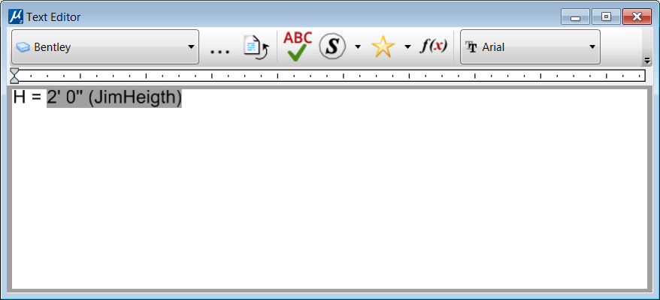
Annotation
Define and place labels in 2D drawings or 3D models
Save labels as named favorites for re-use and automatically retrieve attributes from the 3D model reflected in the label
Labels are automatically updated whenever properties are updated eliminating the need to do so manually
PLEASE NOTE:
*Exact capabilities will be defined when development complete.
*Workflow and user interface will be defined during development.
Notes:
What’s Different in CONNECT: Define and place labels in 2D drawings or 3D models. Save labels as named favorites for re-use and automatically retrieve attributes from the 3D model reflected in the label.
Benefit: Ensure accuracy and consistency while saving time. Labels are automatically updated whenever properties are updated eliminating the need to do so manually.
Annotation Example: If a user creates a label that they place several times in the model/drawing, he/she can update one label and all labels associated will be updated, as well as the labels within the 3D model. He/she can also save labels as a favorite that he/she would like to re-use again reducing the need to re-create a label.

Slide 15
Our Futures are CONNECTED
CONNECTED Users
CONNECTED Projects
CONNECTED Enterprise
Notes:
Bentley CONNECT strategy is comprised of three different aspects of being CONNECTED.
CONNECTED Users
CONNECTED Projects
CONNECTED Enterprise

