Slide 1
Working from home with ProStructures
Johannes Michalowsky, Manager, Technical Support

Slide 2
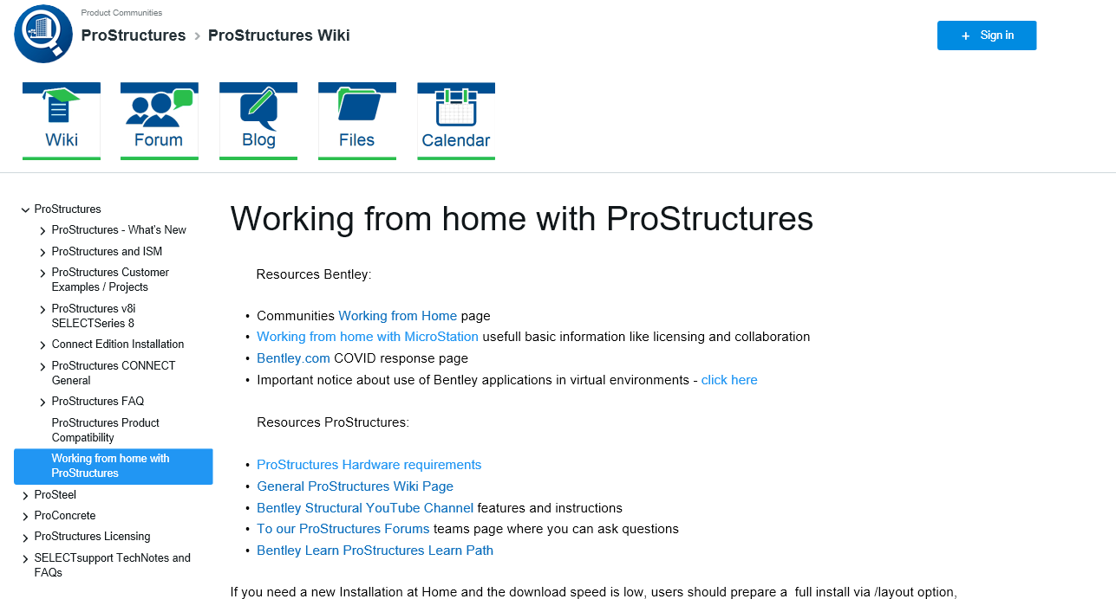
Working from home with ProStructures
Working from home with ProStructures - ProStructures Wiki - ProStructures - Bentley Communities

Slide 3
Working from home with ProStructures
Installation:
Use a company-issued laptop with VPN
Administrators can download a full deployment and install it.
Creating a Deployment Image - ProStructures Wiki - ProStructures - Bentley Communities
Bentley Support can assist Administrators

Slide 4
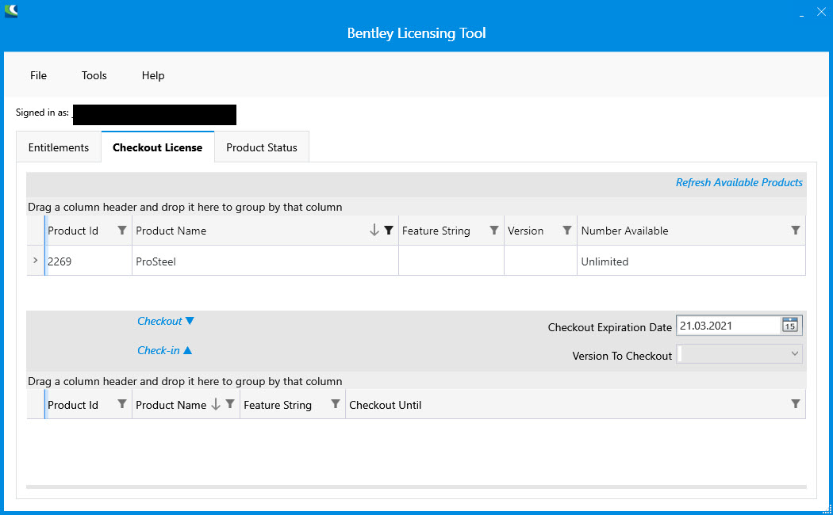
Working from home with ProStructures
License Activation:
Select your Product, Can be used offline for up to seven days
If no internet, use
checked out licenses

Slide 5
Working from home with ProStructures
Network Connectivity impact
License activation

Slide 6
Working from home with ProStructures
Transitioning to a smaller screen size
Customize the user interface
Drag/drop, dock and resize tools and other windows
Reset Dialog Positions - ProStructures Wiki - ProStructures - Bentley Communities

Slide 7
Working from home with ProStructures
Professional Development
Training Courses on YouTube
Many other learning resources

Slide 8
Working from home with ProStructures
For more help
Search the Wiki
Post on the Forum
Submit a Service Request to Support

