Slide 1
MID-AMERICA CADD COMMUNITY CONFERENCE
Using Unsupported Applications in ProjectWise
Mike Dillner
Software Specialist
Mike.Dillner@pec1.com
(785) 233-8300

Slide 2
About Me
Software Specialist with PEC
Little over a year
IT / CADD Support with KS Department of Transportation
7 of 15 years with KDOT

Slide 3
About Professional Engineering Consultants PA (PEC)
Formed in 1965
Full service, multi-discipline firm
More than 300 professionals in seven offices
Wichita
Topeka
Lawrence
Pittsburg
Tulsa
Oklahoma City
Fort Collins

Slide 4
About Professional Engineering Consultants PA (PEC)
Facilities
Mechanical | Electrical | Structural | Telecommunications | Energy
Civil
Transportation | Municipal Services | Water/Wastewater | Land Development
Field Services
Survey | Geotechnical | Materials Testing and Inspection | Commissioning
Air and Water Balance | 3D Scanning
Notes:
Three primary Divisions

Slide 5
Using Unsupported Applications in ProjectWise
Based on Bentley Communities Post:
https://communities.bentley.com/products/projectwise/content_management/f/content-management-forum/125219/unintegrated-third-party-software-workflows
Good reference for the concepts presented here
Resource and reference links
Covers .bat file syntax not presented today
Proof-of-concept only – use at your own risk

Slide 6
Using Unsupported Applications in ProjectWise
The Problem: Applications that spawn additional files through normal use that ProjectWise does not track
HEC-RAS
OneNote
Etc.

Slide 7
HEC-RAS Example – What Happens
User dumps HEC-RAS project (.prj) into ProjectWise
Appears to work fine
Numerous untracked files in DMS directory
High potential for lost work

Slide 8
HEC-RAS Example – What can we do?
Keep the data outside of ProjectWise?
Least amount of work for users
Manage server location & independent access rights
Potential for abuse
Unavailable outside organization

Slide 9
HEC-RAS Example – What can we do?
Folder Managed Export?
Available outside organization
Keeps all files in ProjectWise
Additional work to export / import
Any new files left after import need manually imported
Allows uneducated users to use files without exporting and potentially lose work

Slide 10
HEC-RAS Example – What can we do?
Flat Set Managed Export?
Available outside organization
Keeps all files in ProjectWise
Additional work to export / import
Any new files left after import need manually imported AND added to flat set
Allows uneducated users to use files without exporting and potentially lose work

Slide 11
HEC-RAS Example – What can we do?
Zip Managed Export?
Available outside organization
No accidental misuse within ProjectWise
One document to manage within ProjectWise
Additional work to export / import
Requires user to unzip the files after export, and zip them up before import - keeping the .zip name identical
Potential issues if users attempt to use the files without unzipping them first

Slide 12
HEC-RAS Example – What can we do?
Another solution?
No additional work for users
Available outside organization
No accidental misuse within ProjectWise
One document to manage within ProjectWise
Some assembly required

Slide 13
HecZip Solution – Workflow Overview
ProjectWise HecZip File
Application Entry
Passes the script location, version string, and file location
Passes the version string, and file location
wscript.exe
File checked back into ProjectWise
File and logical set members copied out on open
VBScript File
2. Passes extracted .prj location
3. Calls for compression of files
HEC-RAS Application
1. Calls for extraction of files
Zip Utility
Opens .prj file and
Spawns additional files through use
Extract files
Extract files
Compress files
Local HecZip File
HEC-RAS Files

Slide 14
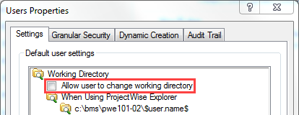
HecZip Solution - Warnings
Relies on consistent DMS directory
Restrict users from altering DMS directory
Application version specific
Assumes default application install directory
Example code only – Use at your own risk

Slide 15
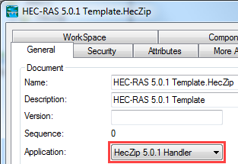
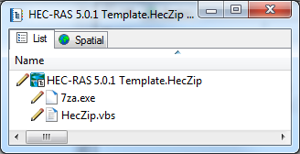
HecZip Solution – Template Document
Zip File with custom extension - .HecZip
Contains only empty HEC-RAS project: HEC-RAS.prj
Uses “HecZip [version] Handler” application entry
Parent document in logical set
VBScript and zip utility child documents

Slide 16
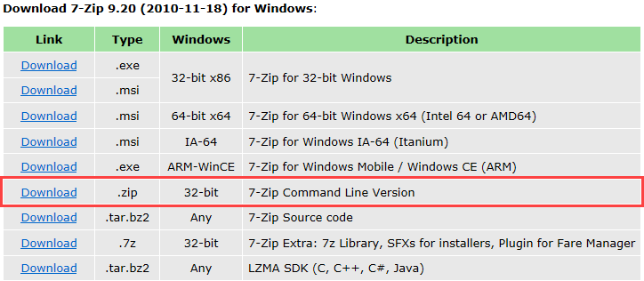
HecZip Solution – Utility Files
7za.exe – Free open source command line zip utility
http://www.7-zip.org/download.html
HecZip.vbs – VBScript that controls:
.HecZip Extraction / Compression
Launching HEC-RAS application

Slide 17
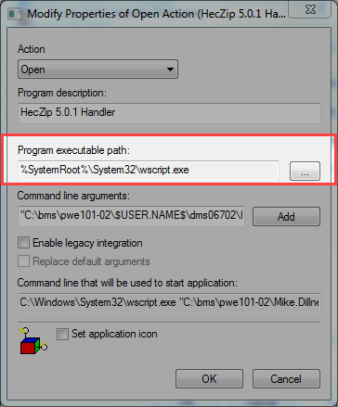
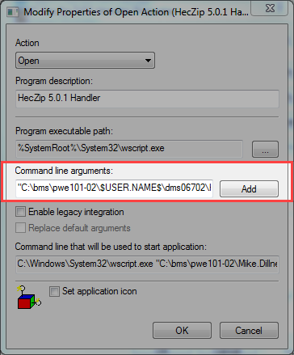
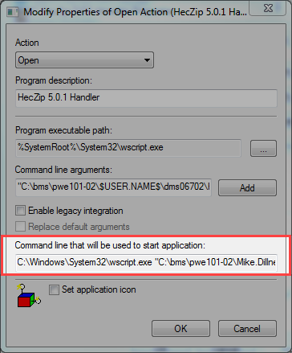
HecZip Solution – Application Entry
Program executable Path:
%SystemRoot%\System32\wscript.exe
Command line arguments:
"C:\bms\pwe101-02\$USER.NAME$\dms06702\HecZip.vbs" "5.0.1"
Command line that will be used to start application:
C:\Windows\System32\wscript.exe "C:\bms\pwe101-02\Mike.Dillner\dms06702\HecZip.vbs" "5.0.1" "%1"

Slide 18
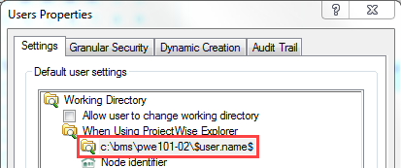
HecZip Solution – Application Entry
Argument 1: "C:\bms\pwe101-02\$USER.NAME$\dms06702\HecZip.vbs"
Starts with DMS root as defined in Users Properties
Ends with DMS directory of VBScript file

Slide 19
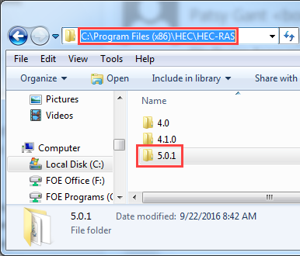
HecZip Solution – Application Entry
Argument 2: "5.0.1"
Version string
Used to construct path to HEC-RAS executable
Avoid multiple scripts for each version
Argument 3: "%1"
Automatically appended by ProjectWise Administrator
Represents the local full path to the file the user clicked on
e.g. “C:\bms\pwe101-02\_test.user\dms06703\HEC-RAS 5.0.1 Template.HecZip”

Slide 20
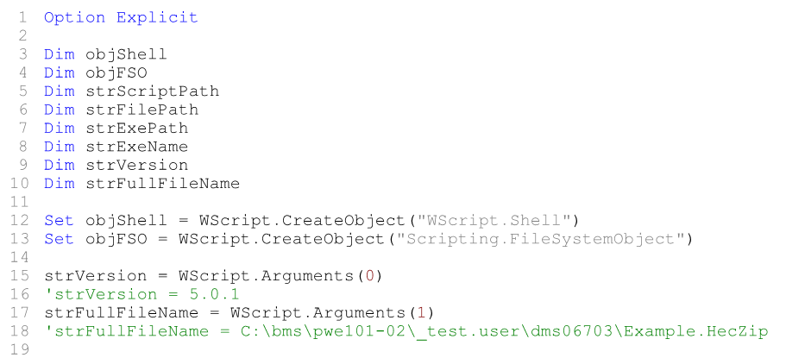
HecZip Solution – Script Contents

Slide 21
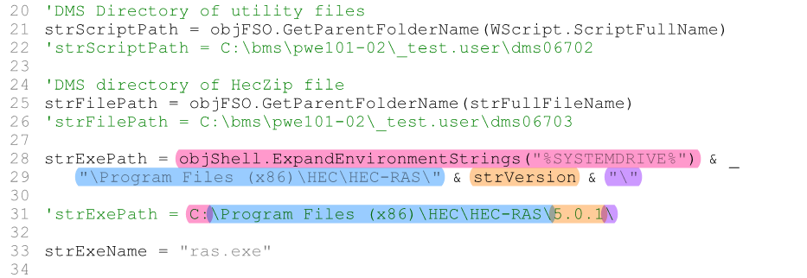
HecZip Solution – Script Contents

Slide 22
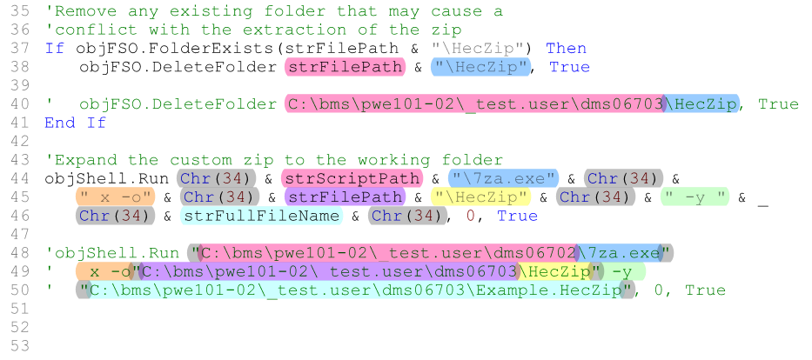
HecZip Solution – Script Contents
DeleteFolder Method
Run Method
7za.exe Command Line Syntax

Slide 23
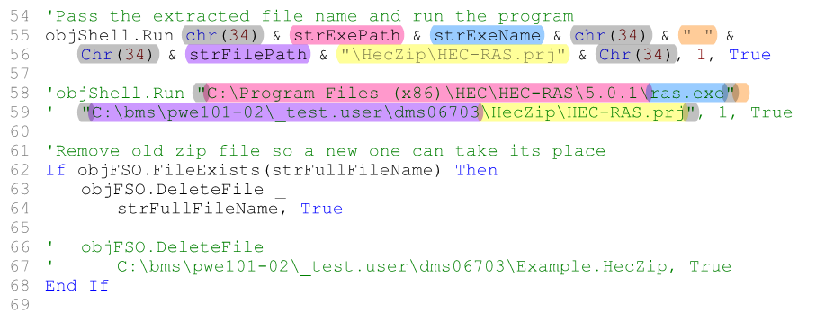
HecZip Solution – Script Contents
DeleteFile Method

Slide 24
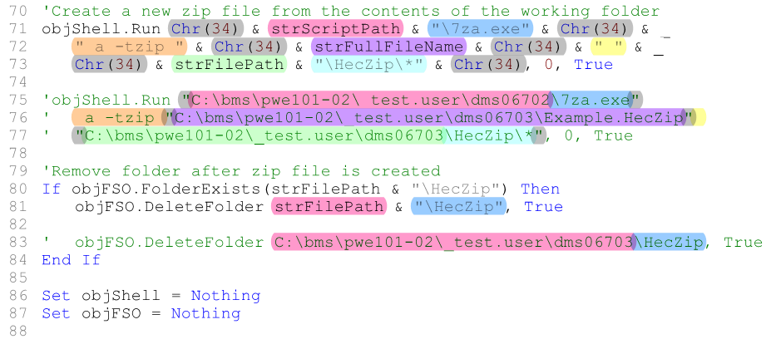
HecZip Solution – Script Contents

Slide 25
HecZip Solution – Logical Set Creation
How do we know Utility Files exist locally?
Flat Set?
Managed Workspace?
Logical Set?

Slide 26
HecZip Solution – Logical Set Creation
Create Placeholder DGNs
Name similar to HecZip Template & Utility files
Create Logical Set
Open parent DGN – HEC-RAS.HecZip.dgn
Reference child DGNs – 7za.exe.dgn, HecZip.vbs.dgn
Close parent DGN – HEC-RAS.HecZip.dgn
Check-in all files

Slide 27
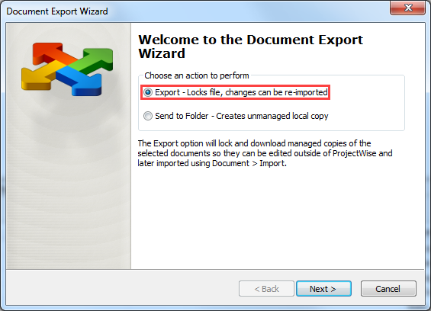
HecZip Solution – Logical Set Creation
Replace Files
Managed Export DGNs

Slide 28
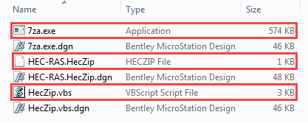
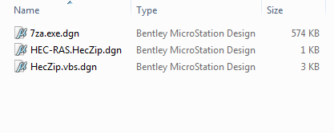
HecZip Solution – Logical Set Creation
Replace Files
Replace DGNs with HecZip Template & Utility files
Import fake DGNs

Slide 29
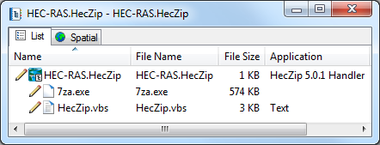
HecZip Solution – Logical Set Creation
Restore File Name and Application
Remove .dgn extension from file names
Reset Application property

Slide 30
HecZip Solution – Summary
Questions?
ProjectWise HecZip File
Application Entry
Passes the script location, version string, and file location
Passes the version string, and file location
wscript.exe
File checked back into ProjectWise
File and logical set members copied out on open
VBScript File
2. Passes extracted .prj location
3. Calls for compression of files
HEC-RAS Application
1. Calls for extraction of files
Zip Utility
Mike Dillner
Software Specialist
Mike.Dillner@pec1.com
(785) 233-8300
Opens .prj file and
Spawns additional files through use
Extract files
Extract files
Compress files
Local HecZip File
HEC-RAS Files

Slide 31
Thank You!
Mike Dillner
Software Specialist
Mike.Dillner@pec1.com
(785) 233-8300

Slide 32
HecZip Solution – Reference Documentation

