Slide 1
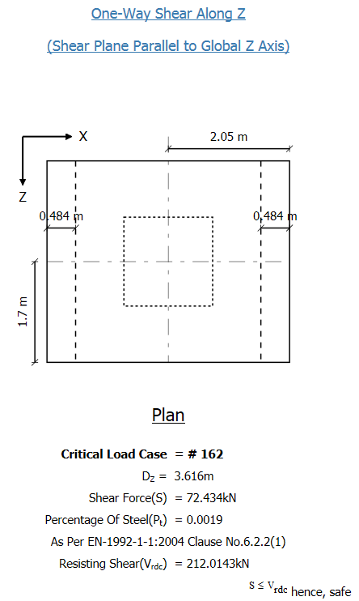
One way shear check of isolate footing in Staad foundation advanced v8.0.1.33
Dimension footing: Length 4.1m; Width 3.4m; Thickness 0.9m
One way shear acc. Eurocode in Staad fdn
3.4m
4.1m
Hand caculation: fck= 25 Mpa
Shear resistance of concrete acc. to EN-1992-1-1 clause 6.2.2(1):
Vrd,c=Crd,c*k*(100*ρ*fck)^{1/3} bd= 0.12*1.495*(100*0.0019*25)^{1/3}*3.4*0.816*1000 = 836.67 kN
>> Vrdc of Staad fdn V8.0.1.33
k = 1 + sqrt(200/d) = 1+sqrt(200/816) = 1.495 < 2

Slide 2
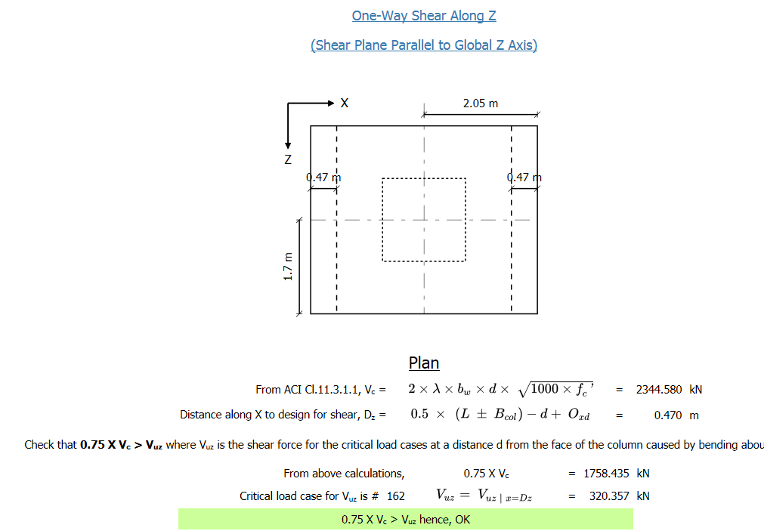
One way shear check of isolate footing in Staad foundation advanced v8.0.1.33
Dimension footing: Length 4.1m; Width 3.4m; Thickness 0.9m
One way shear acc. ACI318 in Staad fdn
3.4m
4.1m
Hand calculation : f’c= 25 Mpa
Concrete shear strength acc. to ACI318-2005 section 11.12.3.1:
Vc=0.17sqrt(f’c)bd = 0.17sqrt(25)*3.4*0.83*1000 = 2398.7 kN ~ Vc of Staad fdn V8.0.1.33

