Slide 1
The Power of ProSteel V8i Ss8 Umsteigen auf die neueste Version von ProSteel
Notes:
Welcome to the eSeminar The Power of ProSteel V8i Ss8 why you should migrate from AutoCAD, I am Johannes Michalowsky Expert Support Engineer from Bentley Systems, the second Part will be done by Tegel Zarate Application Engineer from Bentley Systems

Slide 2
Warum umsteigen?
Kosten Sparen
Vorhandene Zeichnungen (dwg) einfach öffnen und weiterarbeiten
Einfache Migration Ihrer Daten (Vorlagen, Materialdatenbanken, Stile)
Neuerungen S8
ProSteelTools
Vorteile Plattform MicroStation
Notes:
No platform cost, a lot of output formats are available, integration in other Bentley products, due to the high Performance in Bentley Rendered View you can permanently working in shaded mode, one has all the advantages of the MicroStation environment, and great visualization tools

Slide 3
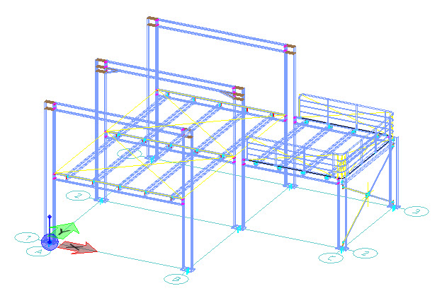
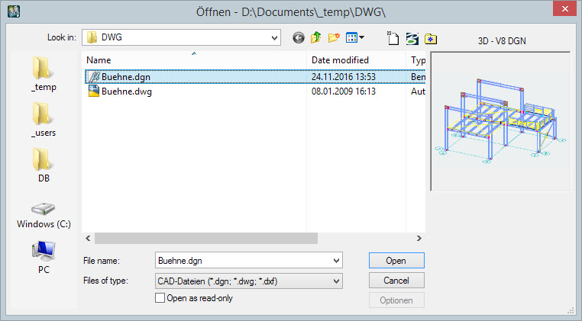
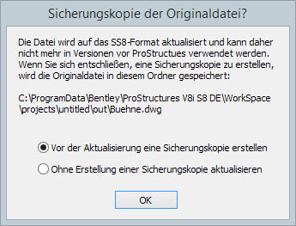
Was ist neu in S8?
DWG Adapter für alle ProSteel und AutoCAD Objekte
Notes:
With Lumen RT you can create great visuals on the fly, or embed the environment of your client with Context Capture.

Slide 4
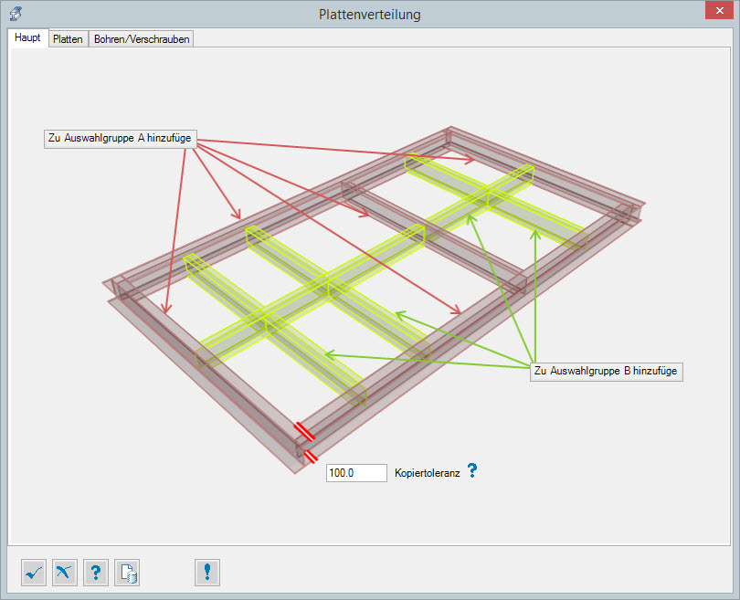
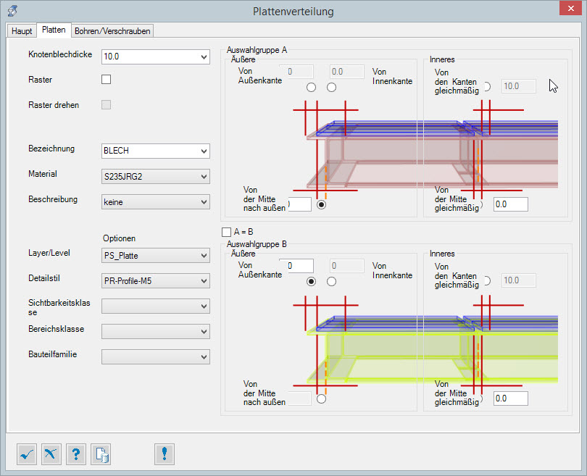
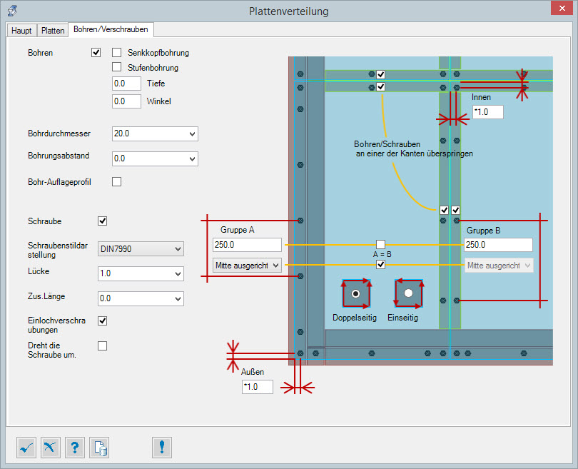
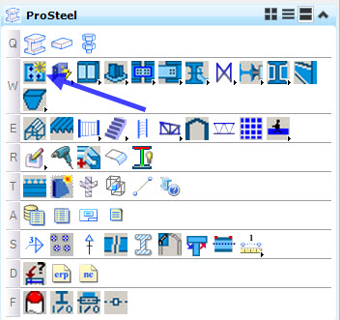
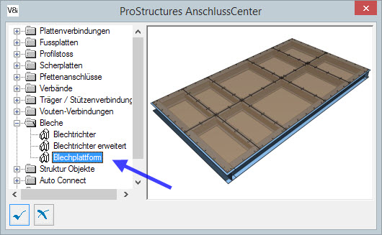
Was ist neu in S8?
Plattenverlegetool
Notes:
With Lumen RT you can create great visuals on the fly, or embed the environment of your client with Context Capture.

Slide 5
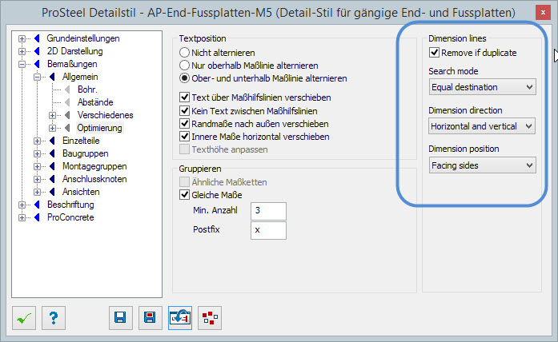
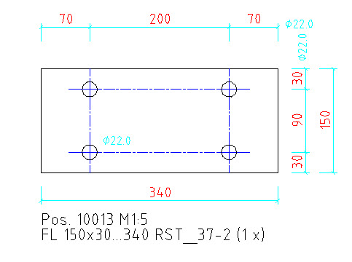
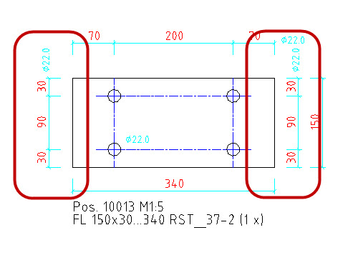
Was ist neu in S8?
Detailcenter Optimierung Bemassung
Notes:
With Lumen RT you can create great visuals on the fly, or embed the environment of your client with Context Capture.

Slide 6
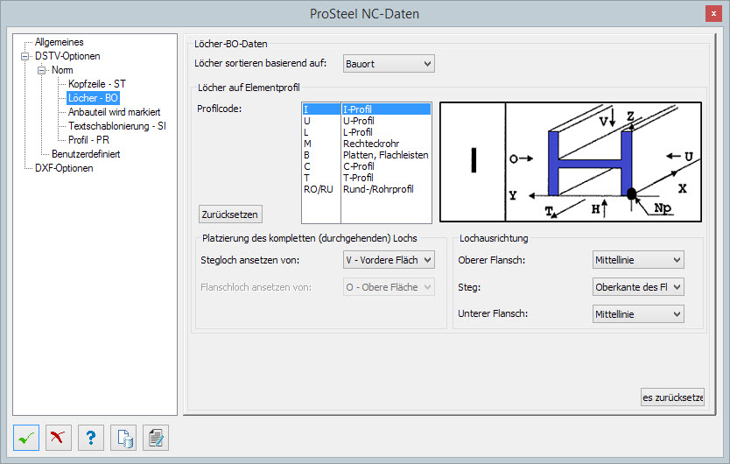
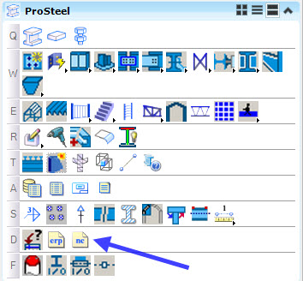
Was ist neu in S8?
NC Ausgabe komplett überarbeitet
Notes:
With Lumen RT you can create great visuals on the fly, or embed the environment of your client with Context Capture.

Slide 7
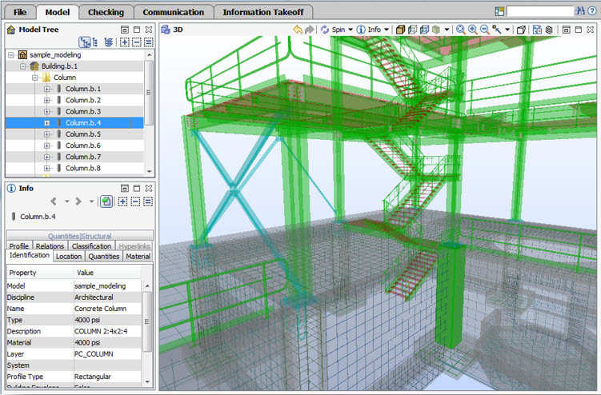
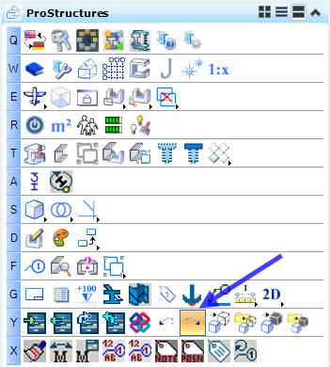
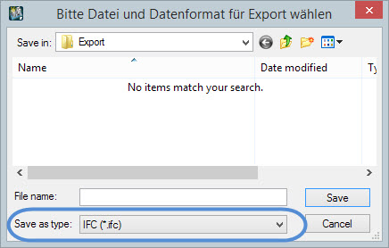
Was ist neu in S8?
IFC Export
Notes:
With Lumen RT you can create great visuals on the fly, or embed the environment of your client with Context Capture.

Slide 8
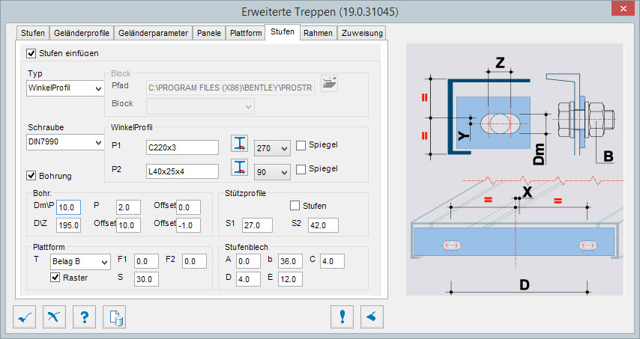
Was ist neu in S8?
Treppe erweitert mit verschiedenen Optionen zum Beispiel für Stufen
Notes:
With Lumen RT you can create great visuals on the fly, or embed the environment of your client with Context Capture.

Slide 9
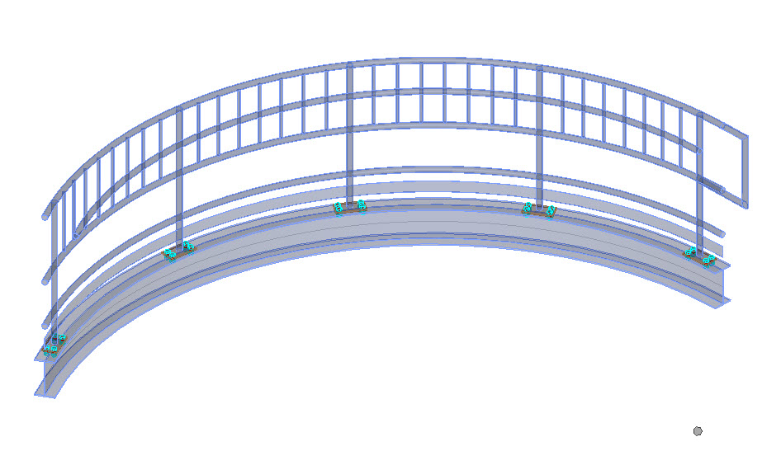
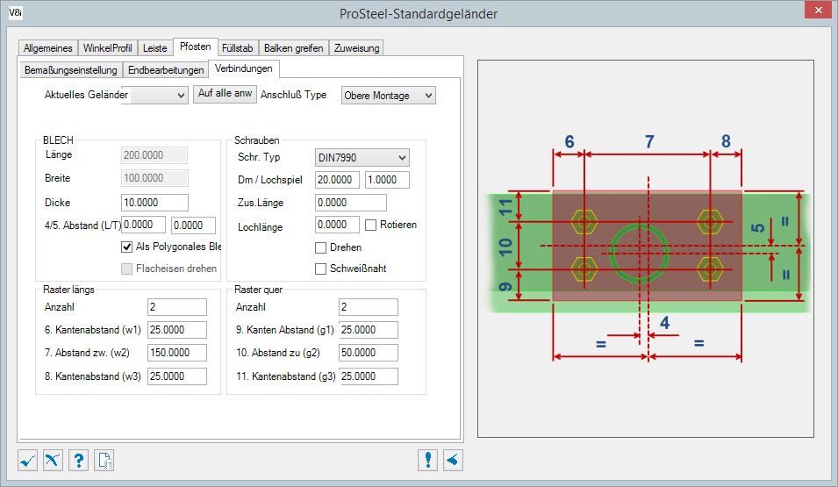
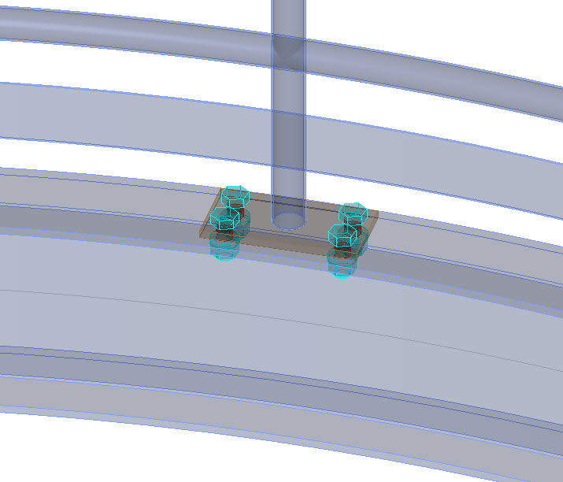
Was ist neu in S8?
Verbesserungen Geländer
Notes:
With Lumen RT you can create great visuals on the fly, or embed the environment of your client with Context Capture.

Slide 10
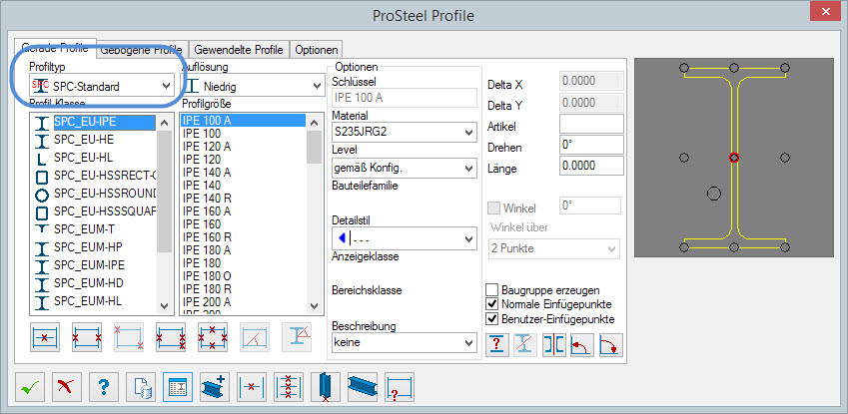
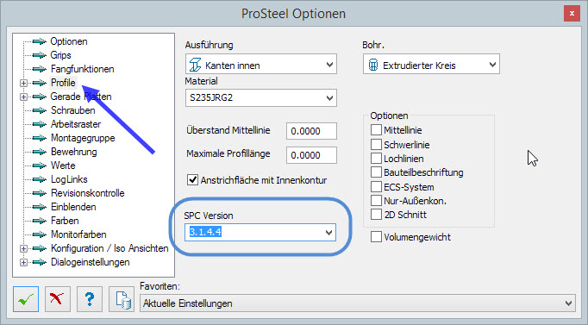
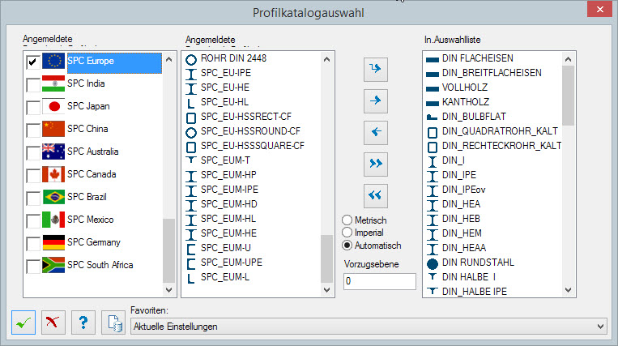
Was ist neu in S8?
SPC Profilkatalog
Notes:
With Lumen RT you can create great visuals on the fly, or embed the environment of your client with Context Capture.

Slide 11
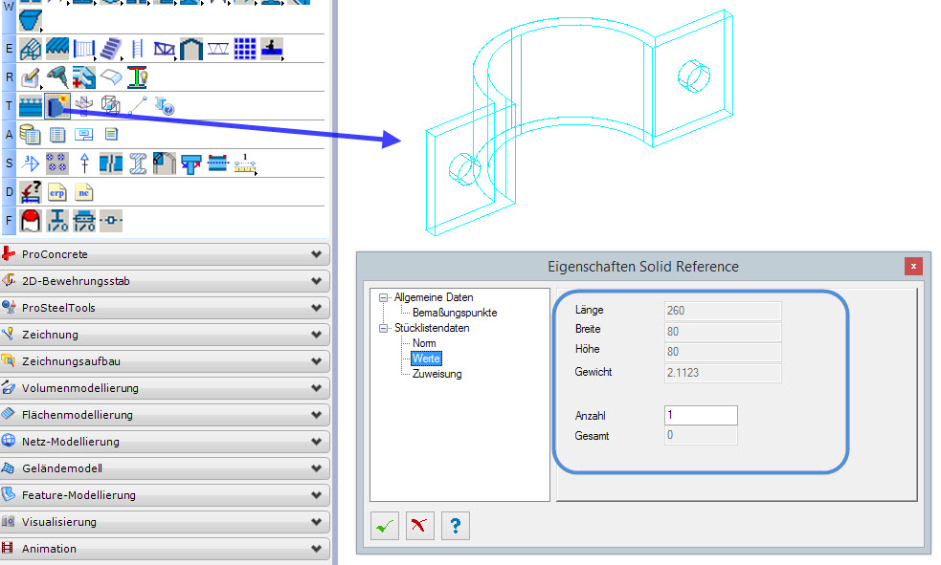
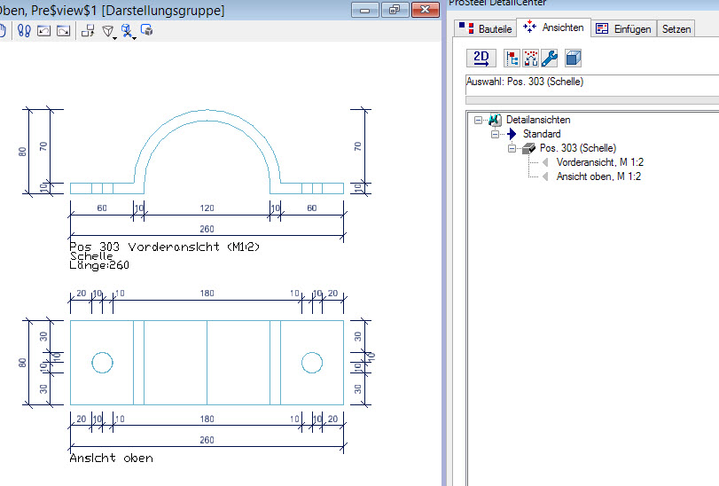
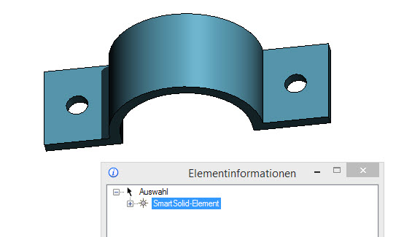
Was ist neu in S8?
Solid Reference
Smartsolids (Volumenkörper) als ProSteel Solid Reference verwenden
Korrekte Berechung des Gewichts anhand Volumen und ProSteel Materialzuweisung
Ausarbeitung als Einzelteil möglich
Notes:
With Lumen RT you can create great visuals on the fly, or embed the environment of your client with Context Capture.

Slide 12
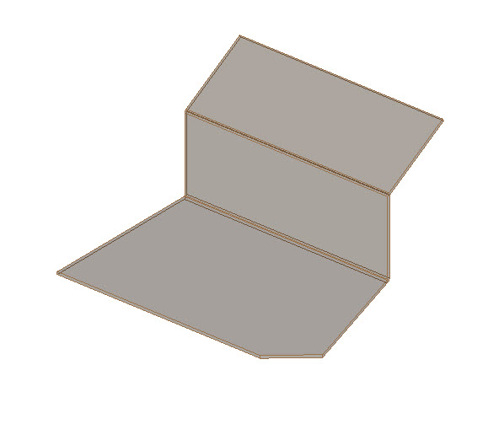
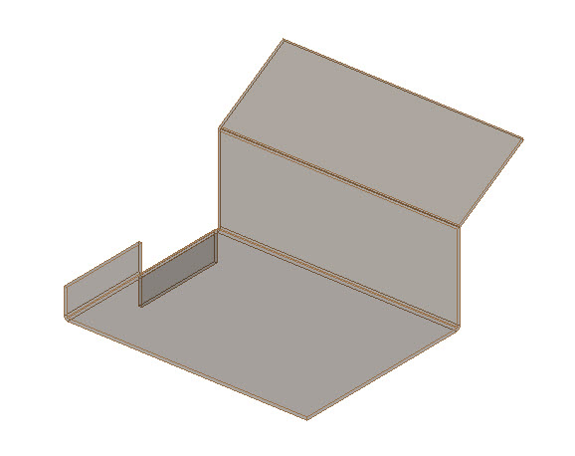
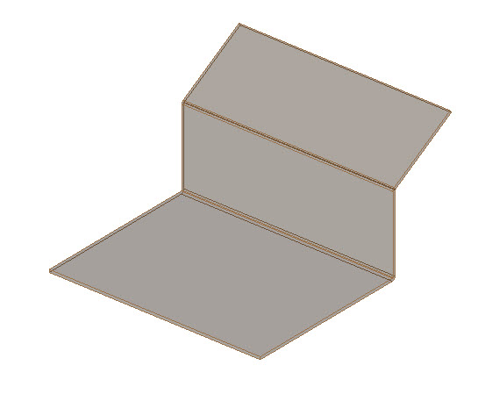
Was ist neu in S8?
Abkantungen – Kantenanzahl verändern
Notes:
With Lumen RT you can create great visuals on the fly, or embed the environment of your client with Context Capture.

Slide 13
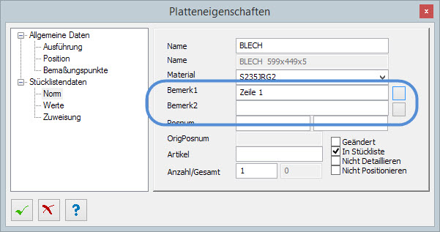
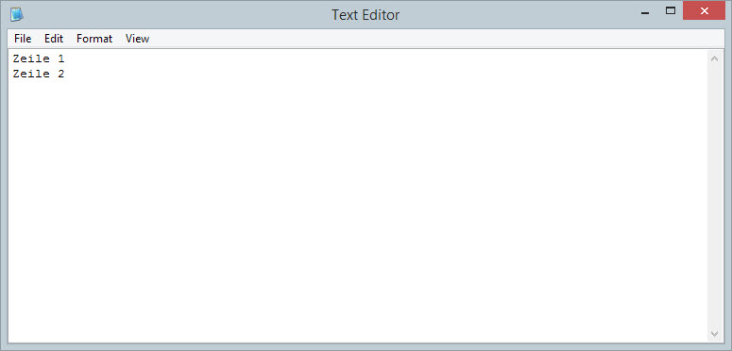
Was ist neu in S8?
Bemerkungen mehrzeilig möglich
Notes:
With Lumen RT you can create great visuals on the fly, or embed the environment of your client with Context Capture.

Slide 14
Vorteile PowerProSteel
AccuDraw
Direkter 3D PDF Druck
Abwicklungen
Import/Export
ContextCapture
Lumen RT
Notes:
With Lumen RT you can create great visuals on the fly, or embed the environment of your client with Context Capture.

Slide 15
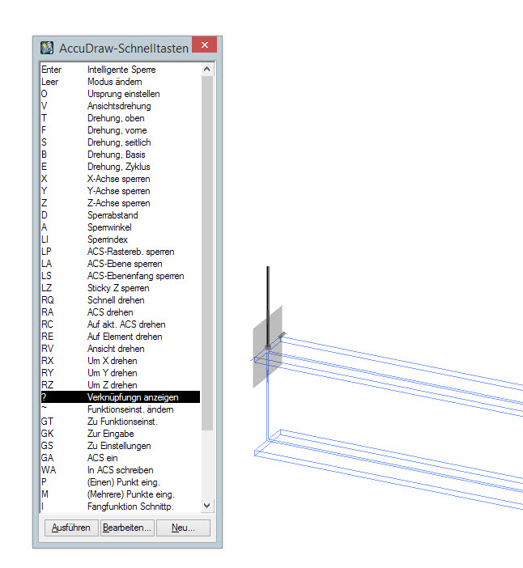
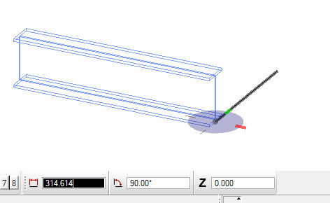
Vorteile PowerProSteel
AccuDraw
Notes:
With Lumen RT you can create great visuals on the fly, or embed the environment of your client with Context Capture.

Slide 16
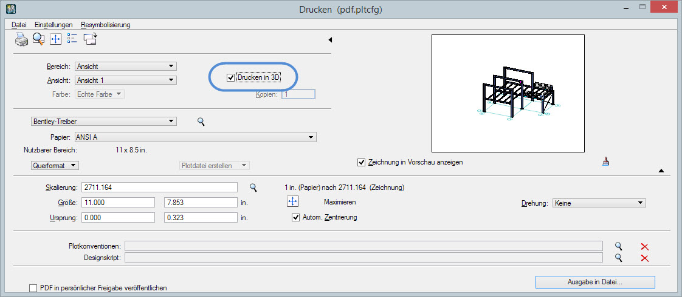
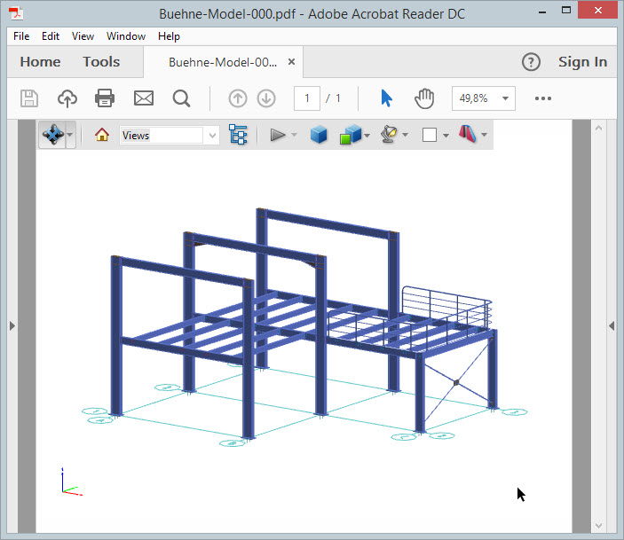
Vorteile PowerProSteel
Direkter 3D PDF Druck
Notes:
With Lumen RT you can create great visuals on the fly, or embed the environment of your client with Context Capture.

Slide 17
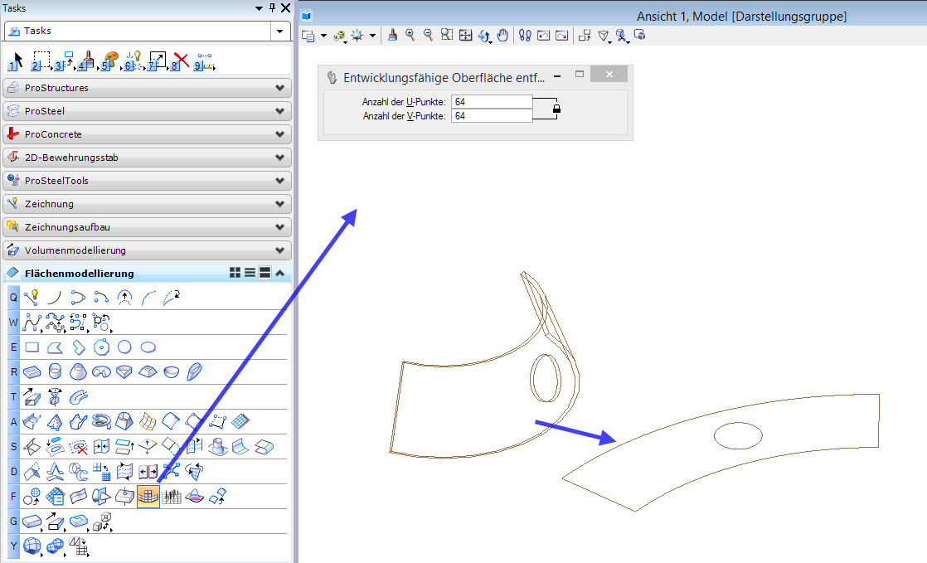
Vorteile PowerProSteel
Abwicklungen
Notes:
With Lumen RT you can create great visuals on the fly, or embed the environment of your client with Context Capture.

Slide 18
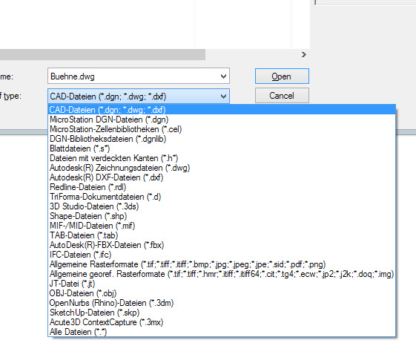
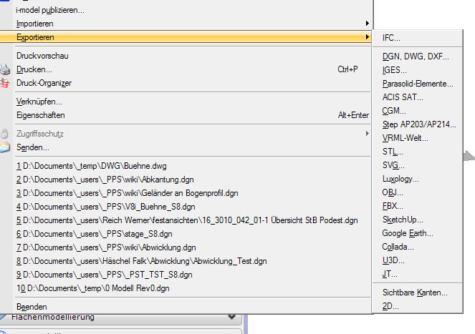
Vorteile PowerProSteel
Import/Export
Notes:
With Lumen RT you can create great visuals on the fly, or embed the environment of your client with Context Capture.

Slide 19
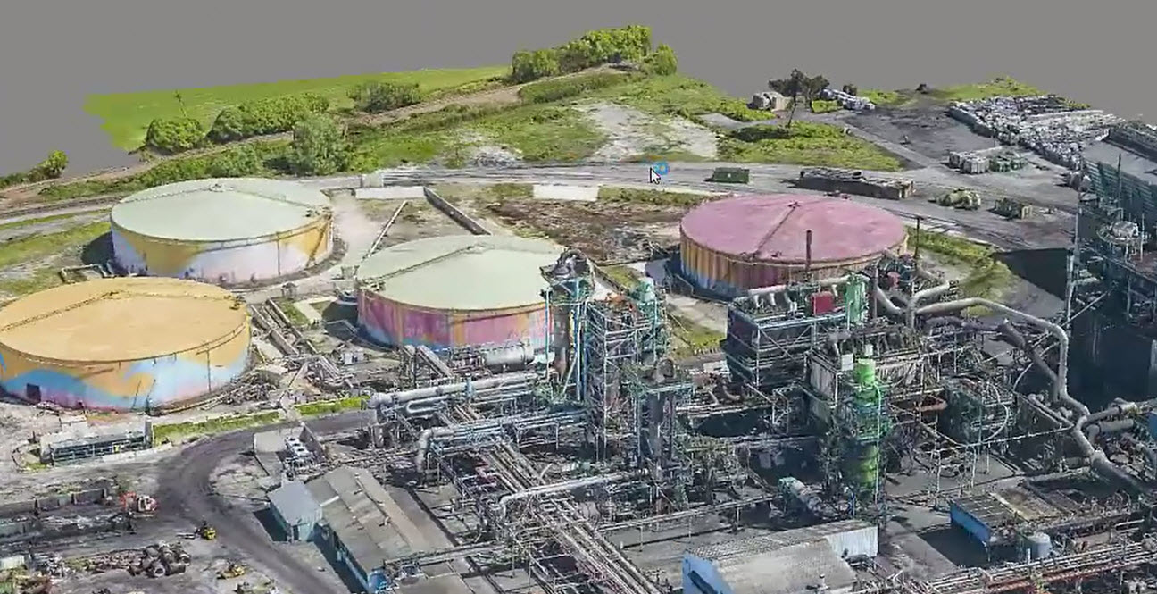
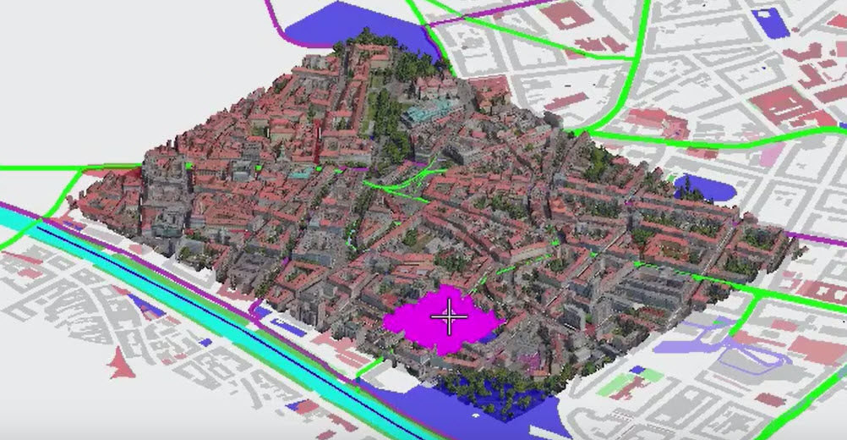
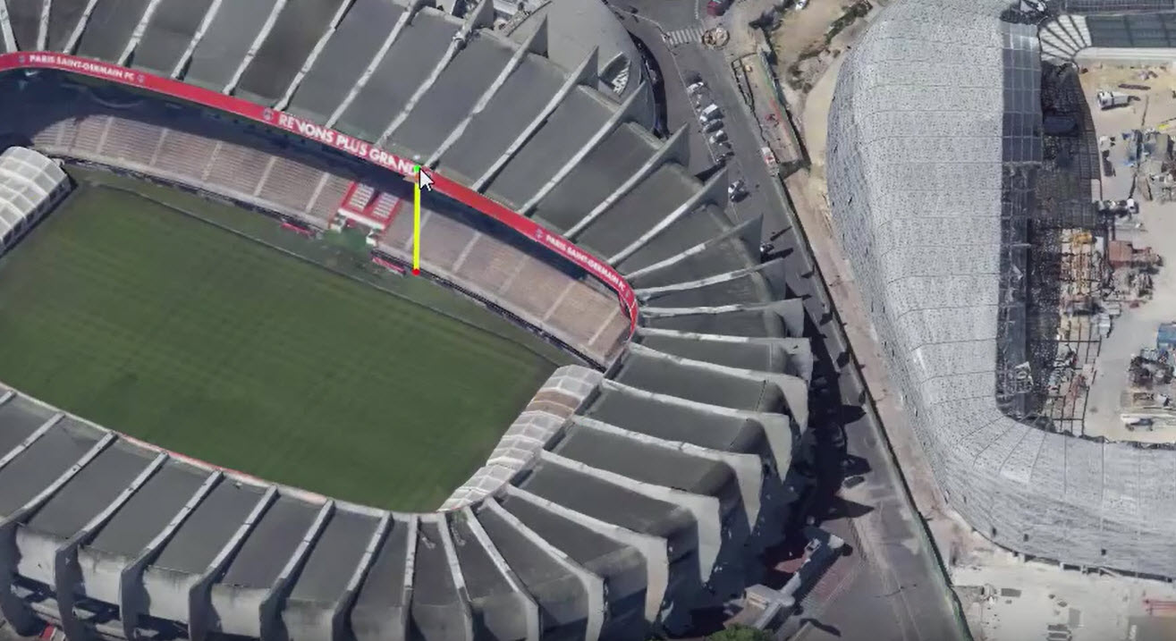
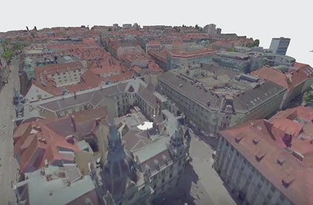
Vorteile PowerProSteel
ContextCapture
Notes:
With Lumen RT you can create great visuals on the fly, or embed the environment of your client with Context Capture.

Slide 20
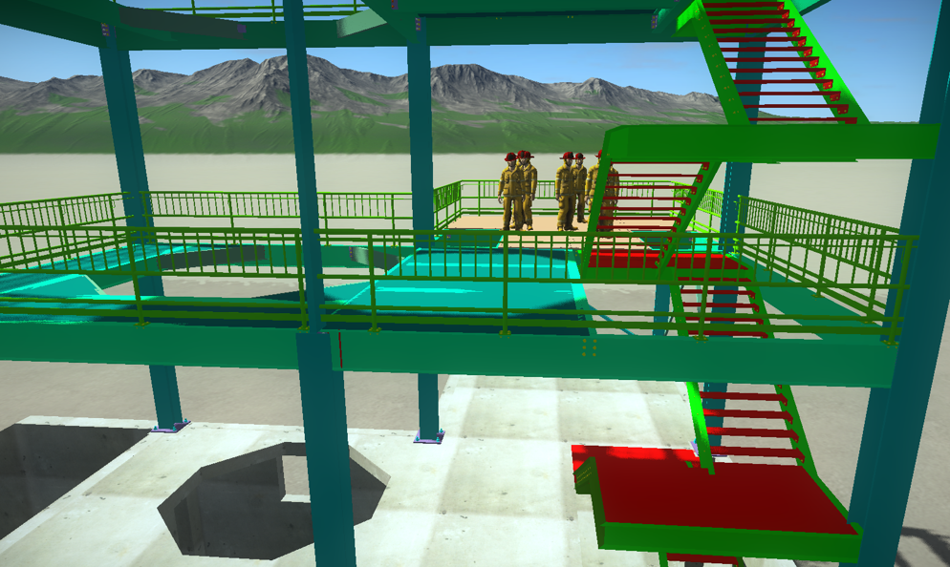
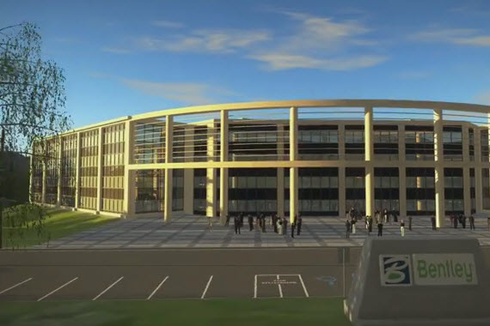
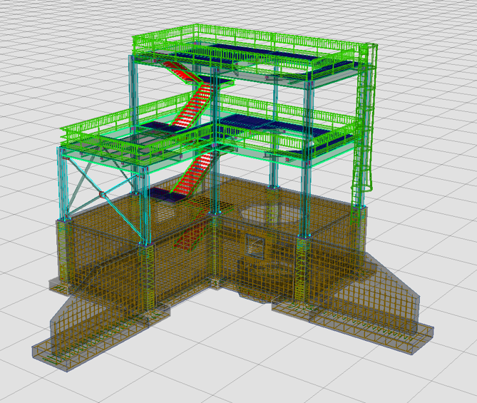
Vorteile PowerProSteel
Lumen RT
Notes:
With Lumen RT you can create great visuals on the fly, or embed the environment of your client with Context Capture.

Slide 21
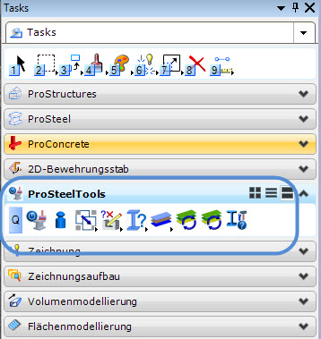
ProSteelTools
Mehr Werkzeuge
Mehr Funktionen
Notes:
With Lumen RT you can create great visuals on the fly, or embed the environment of your client with Context Capture.

Slide 22
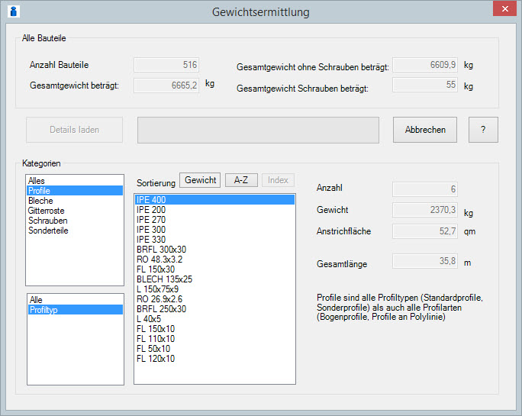
ProSteelTools
Gewichtsermittlung Detaillierte Ansicht
Notes:
With Lumen RT you can create great visuals on the fly, or embed the environment of your client with Context Capture.

Slide 23
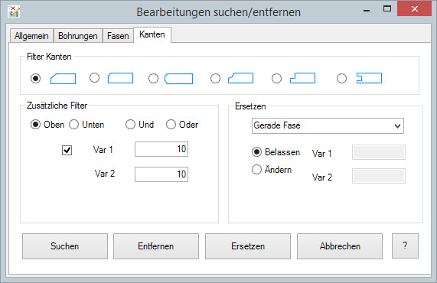
ProSteelTools
Bearbeitungen erweitert - Kanten
Notes:
With Lumen RT you can create great visuals on the fly, or embed the environment of your client with Context Capture.

Slide 24
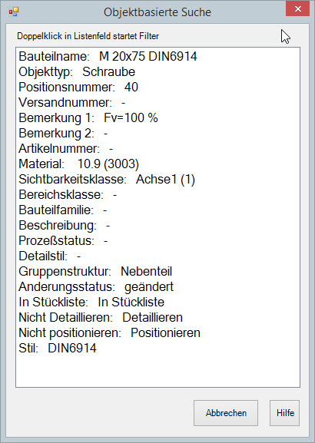
ProSteelTools
Objektbasierte Suche
Neuer Dialog
Mehr Auswahl an Daten
Auch Schraubenstil
Auch Positionsfahnenstil
Notes:
With Lumen RT you can create great visuals on the fly, or embed the environment of your client with Context Capture.

Slide 25
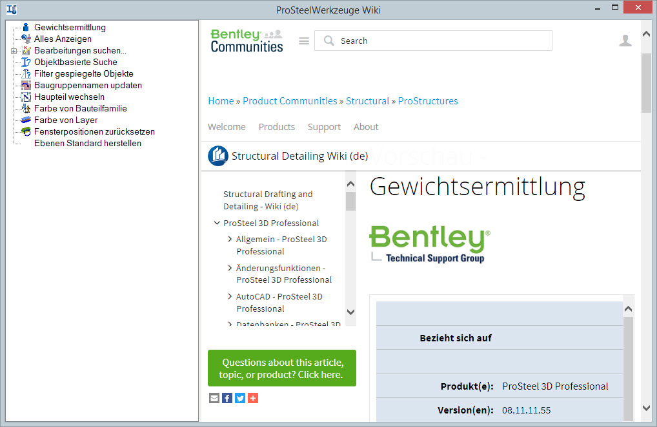
ProSteelTools
Neue Hilfefunktion basierend auf Bentley Communities Wikis
Notes:
With Lumen RT you can create great visuals on the fly, or embed the environment of your client with Context Capture.

Slide 26
Links
Neuerungen S8 (Englisch)
Vorteile PowerProStructures
MicroStation Grundlagen
ContextCapture YouTube Video
LumenRT YouTube Video
Download PowerProStructures Bentley FulfillmentCenter
Notes:
With Lumen RT you can create great visuals on the fly, or embed the environment of your client with Context Capture.

Slide 27
THANK YOU www.bentley.com/prosteel

