Slide 1
Advanced Intersection Design with Roadway Designer
Chuck Lawson
GEOPAK Product Engineer

Slide 2
Intersection Design
Designing an intersection can be a complex and iterative process. There are an abundance of criteria to consider such as min/max slopes, stopping sight distance, drainage and R/W constraints – just to name a few.
There are many techniques in Roadway Designer that can be used to model intersections. This presentation will cover the workflow used to model a skewed intersection. In addition, this method may be used to model an intersection where the mainline roadway is within the limits of a horizontal curve. This method will ultimately work for most intersection types.

Slide 3
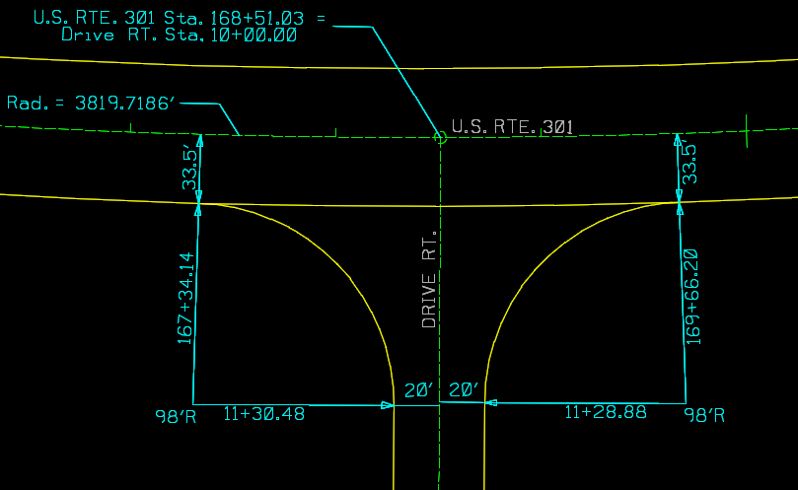
Project Review

Slide 4
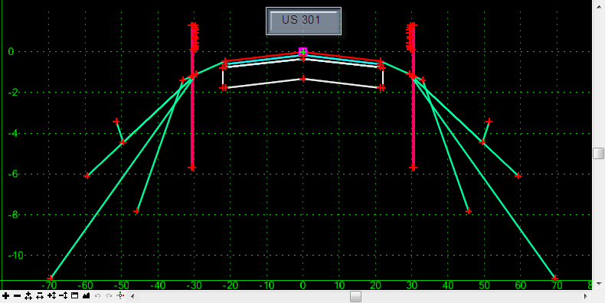
Project Review
Before we begin, let’s review our project data and the template that we’ll be using.
U.S. 301 New Construction Template

Slide 5
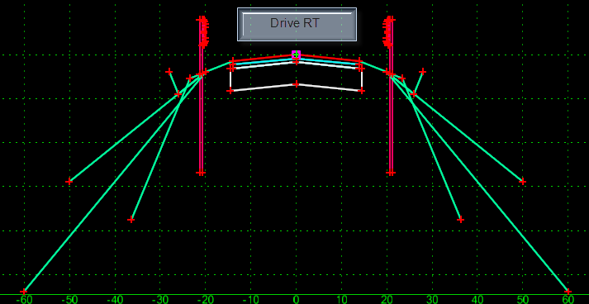
Project Review
Drive RT New Construction Template

Slide 6
Project Review Demo

Slide 7
Creating Corridors
The first step in the process is to create separate corridors for the mainline and the side road.

Slide 8
Creating Corridors Demo

Slide 9
Intersection Design
Now that we have created our corridors, we are ready to begin work on our intersection.
First, we need to produce our radius return geometry, both horizontally and vertically using the Multi-Center Curve application.

Slide 10
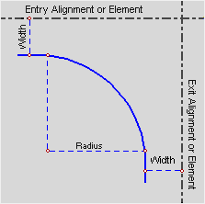
Creating Radius Return Alignments
There are several ways to calculate radius return elevations.
Vertical Offset from PGL
Pavement Slope from PGL
Elevation
Calculate from Surface Model
For this exercise, we’ll demonstrate how to calculate the beginning and ending elevations of the of the returns from a model.

Slide 11
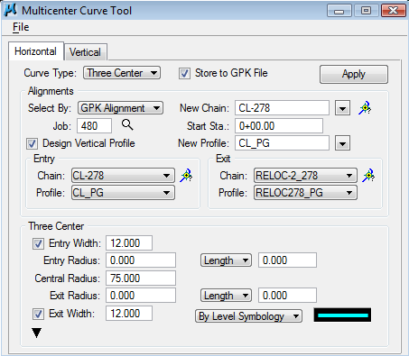
Design Horizontal/Vertical Returns
Through the use of the Multi-Center Curve application, we can have GEOPAK design our preliminary Horizontal and Vertical curb return geometry.

Slide 12
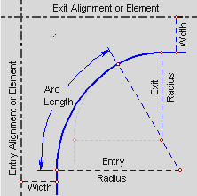
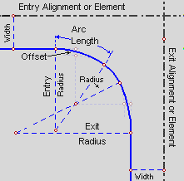
Design Horizontal/Vertical Returns
The Multi-Center Curve application can create one-center, two-center or three-center compound curves at the intersection of two alignments. The applications creates a new horizontal alignment in the geometry database and, if desired, a vertical alignment as well.

Slide 13
Design Horizontal/Vertical Returns Demo

Slide 14
Integrate Returns into Side Road
Now that we have the horizontal and vertical geometry for our curb returns, we can integrate this geometry into the design of the intersection.

Slide 15
Integrate Returns into Side Road
Change the template drop location of the side road corridor DriveRT to not include the radius returns
Create corridors of both radius returns
Drop templates into each new corridor and modify to only use half sections
Use a point control to target the edge of the mainline corridor
Use a point control to target the side road baseline and profile

Slide 16
Integrate Returns into Side Road Demo

Slide 17
Combining the Corridors
Turn on “Target Aliasing” for both radius return corridors to target and clip the mainline corridor
Create a combine surface clipping off the end conditions along the mainline corridor

Slide 18
Combining the Corridors Demo

Slide 19
Fine Tuning the Model
Lastly, we look for any issues or problems with the intersection that may need to be corrected.
Some examples may include:
Fill slope transitions
End Condition Exceptions
Parametric Constraints
Ditch width transitions
Adjusting Corridor limits for tolerance issues
Transitioning Shoulder Widths / Slopes
Etc.

Slide 20
Fine Tuning the Model Demo

Slide 21
Advanced Intersection Design with Roadway Designer
Chuck Lawson
GEOPAK Product Engineer

